Slide 2
No-Touch Bird Calls Display
SD1319 – Team Rocket
Advisor: Dr. Glower
Client: Red River Valley Zoo
Jacob Schulzetenberg
Thomas Schwandt
Andrew Widmer

Slide 3
Objective
A non-touch sensor activated zoo display that activates audio files that play audibly heard bird calls correlated to a poster display of birds from the Red River Zoo and surrounding region.

Slide 4
Requirements Fulfilled

Slide 5
Requirements
Play a minimum of four different bird calls and have availability for expansion.
Our display is capable of playing six different bird calls. These bird calls are stored on a micro SD card. Depending on the software chosen by the zoo the sounds can be changed to six new ones with the press of a button. The Audio playback chip used has the memory capable of playing 255 different sounds.

Slide 6
Requirements
Volume should be at a level (dB) easy to hear in outside environment.
A power amplifier was added to increase the volume of the animal sounds. This power amplifier greatly amplifies the signal coming from the audio playback chip. A speaker is also used that can handle the amount of power across it with the use of this power amplifier.

Slide 7
Rugged Conditions Requirements
3. Unit able to withstand various levels of temperature while maintaining full functionality, temperatures ranging from 25C to 50C.
All Electronic Components used in this project are rated at temperatures with larger ranges than -25C to 50C.

Slide 8
Rugged Conditions Requirements
4. Unit able to withstand various levels of relative humidity ranging from 10% to 100% while maintaining full functionality.
Unit will not have a problem dealing with various levels of humidity.

Slide 9
Rugged Conditions Requirements
5. Unit should have some sort of protective enclosure so that unit functions under precipitation conditions i.e. rain or possibly snow.
Unit has protective aluminum enclosure including a weatherproof speaker, weatherproof stripping around joints, and a Plexiglas cover.

Slide 10
Rugged Conditions Requirements
6. Unit able to withstand various amounts of force due to children and humans interacting on display.
Due to the protective enclosure, the unit is able to withstand normal amounts of user force. The unit could be damaged if direct attempts were made to do so. Preventing these attempts was not the desire of our requirements or our project.

Slide 11
Power Requirements
7. 120 V_{rms} AC Input Voltage
The unit’s power comes from a wall outlet. A basic wall outlet provides 120 V_{rms} AC input voltage. The unit uses a 120 V_{rms} AC voltage to 12V DC wall inverter to power the Product Control Board.

Slide 12
Power Requirements
8. Average power consumption of unit, maximum of 15W
The unit does not use more than 15W of power. The adapter is rated to provide a maximum of 12 W. The individual components of our PCB do not use more than 15W.

Slide 13
Size Requirements
9. From a marketing point of view, aesthetically pleasing so as to attract initial interest.
We believe the poster that was designed is aesthetically pleasing and relatively attractive to the product’s application.

Slide 14
Size Requirements
10. Width and length of a minimum of 50cm by 50cm to a maximum of 180 cm by 180cm.
The dimensions of the unit are 75cm width by 43 cm height by 12 cm depth. These dimensions are suitable. Although the height is less than 50 cm that was the necessary height used based on available enclosures.

Slide 15
Size Requirements
11. Depth of less than 30 cm.
The depth is 12cm. This is less than 30 cm.

Slide 16
Size Requirements
12. Unit able to be relocated easily due to a number of zoo reasons (including peak weather conditions)
The unit is not heavy with a weight less than 15 kg. The chord is less than 5 meters and can easily be wound up. The unit is attached and secured well inside the enclosure so as not to be incredibly fragile.

Slide 17
Size Requirements
13. Unit should have some sort of security system, locking it into place, preventing unauthorized removal.
This will depend on how the zoo staff chooses to mount the unit. However, the breaker switch is inside the bolted on cover so as to prevent unauthorized power down.

Slide 18
Size Requirements
14. Unit should be under 70 lbs. or 32 kg.
Unit weighs less than 32 kg.

Slide 19
User Interface Requirements
15. Should have an on and off switch capability to prevent power consumption during non business and non-operation hours.
There is an on off switch, a breaker that can be used to turn the unit on or off. The unit can also be unplugged to turn off, and plugged in to turn on.

Slide 20
User Interface Requirements
16. User interface including scrolling LCD display showing temperature, time date, humidity, etc.
An LCD display was not used.

Slide 21
User Interface Requirements
17. Sensors to activate the corresponding animal display sounds (such available sensors could be: passive infrared, light, motion, or any combination of these within the unit.)
We used Infrared Proximity sensors. The sensors are activated by motion within approximately 15 – 25 cm from the display Plexiglas. This is a desired distance, as to prevent unintended activation.

Slide 22
TECHNICAL INFORMATION

Slide 23
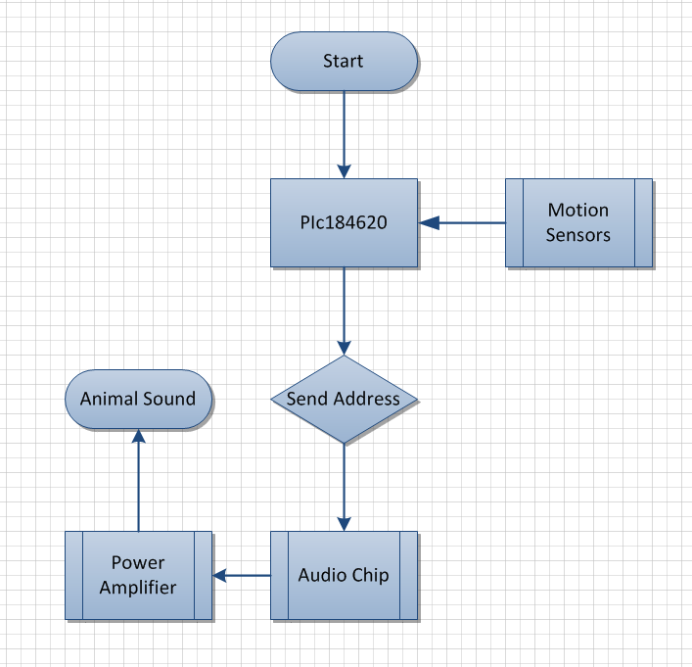
Schematic Flowchart

Slide 24
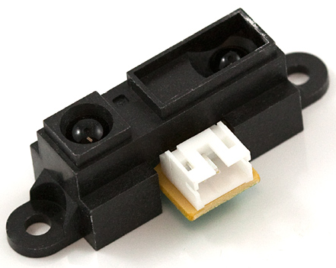
Finalized Sensor
IR Proximity Sensor
Ideal range
+5V, GND, V_{out}
No external control circuit
Other Sensors Tested and Decided Against:
Light Sensor – unpredictable due to sunlight and shadows
Capacitive Touch Sensor – unable to work through Plexiglas
PIR Motion Sensor – too much range, too sensitive
Digital Proximity Sensor – unnecessary to use I²C, size

Slide 25
PIC18F4620
Monitors inputs from proximity sensors
Sends address of audio file to be played

Slide 26
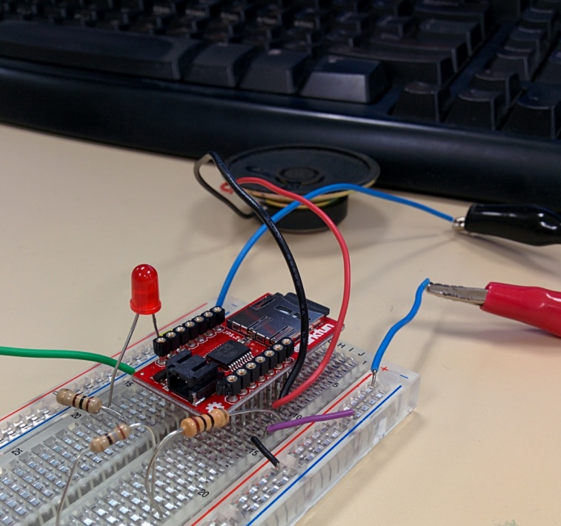
Audio Breakout WTV020SD
Uses 2 line serial interface
Clock & Data Input from PIC
PWM output for audio amplifier
Plays .ad4 audio files
32kHz mono WAV input, 4 Bit .ad4 output
Supports up to 512 files on microSD
2GB max capacity (FAT16 file format)

Slide 27
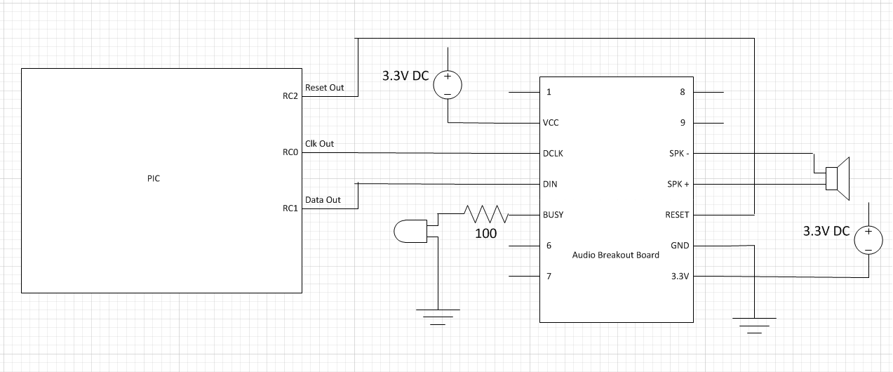
Audio Breakout Schematic

Slide 28
Serial Commands
Code | Function
FFF0H～FFF7H | Volume Adjustment
FFFEH | Play/Pause
FFFFH | Stop
Filename (.ad4) | Data Trigger (Binary)
0000 | 0000000000000000
0001 | 0000000000000001
…. | ….
0511 | 0000000111111111

Slide 29
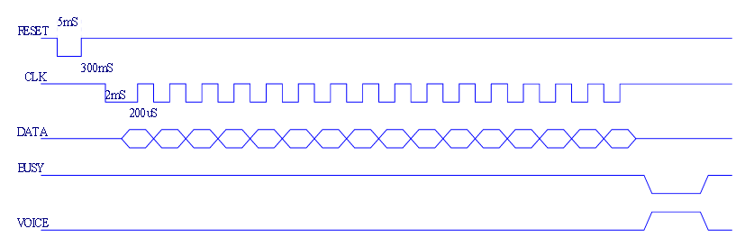
Software
Timing Diagram for Audio Chip

Slide 30
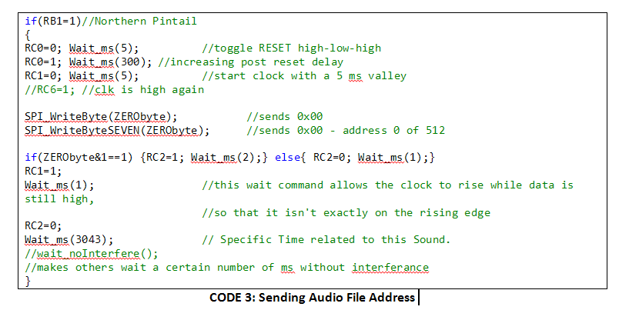
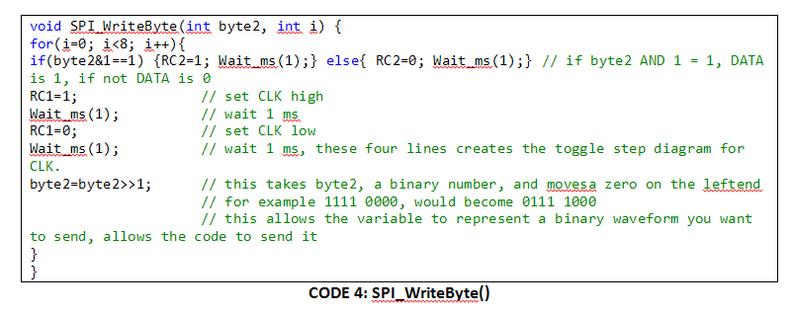
Software

Slide 31
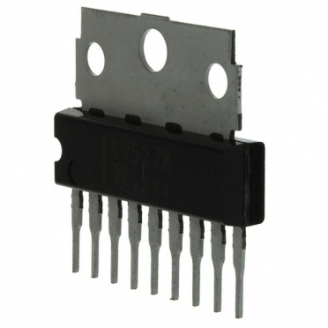
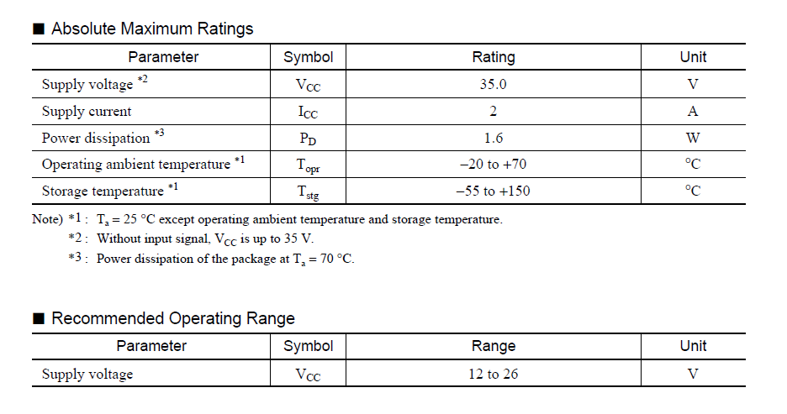
Volume Amplification

Slide 32
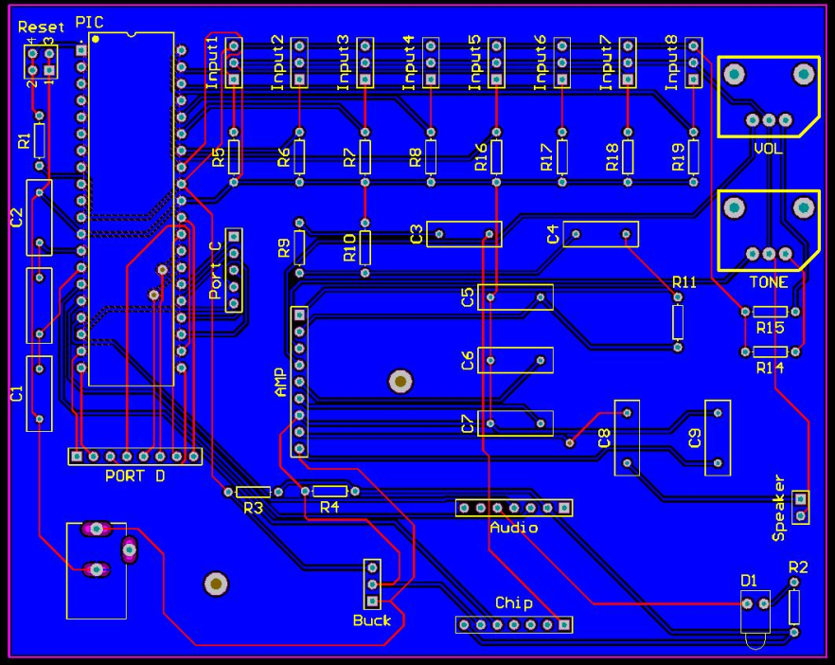
PCB

Slide 33
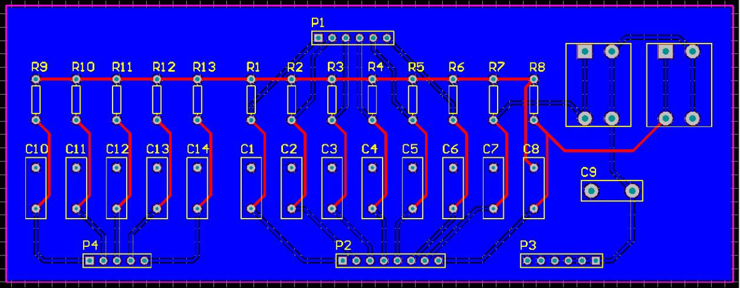
PIC18F4620 on PCB
Initially PIC damaged due to excessive noise on floating pins
Drop down resistors, filtering capacitors applied to I/O pins
PCB Added

Slide 34
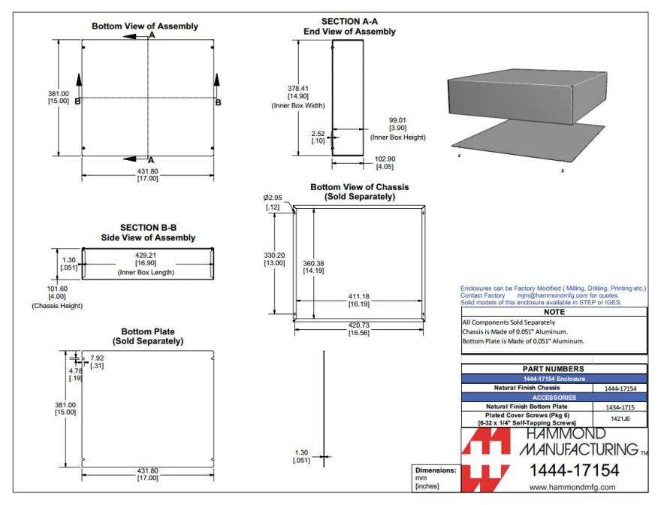
Enclosure
Decided on two Aluminum Chassis from Hammond Manufacturing
Durable
Correct Size
Price

Slide 35
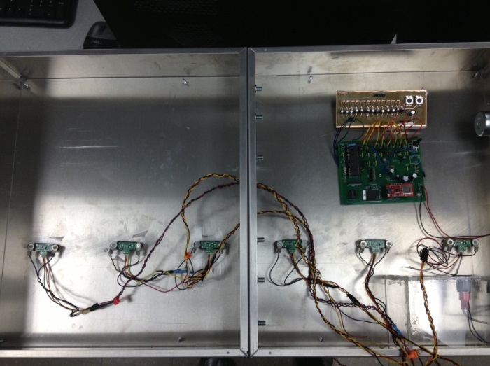
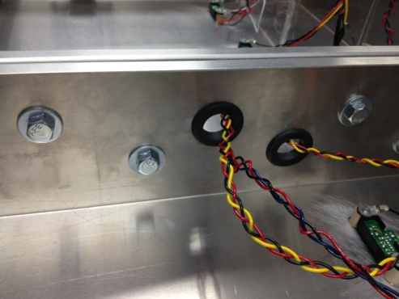
Enclosure

Slide 36
Testing & Evaluation

Slide 37
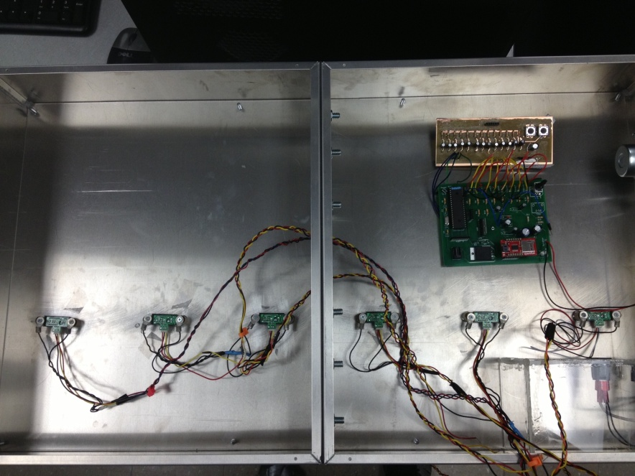
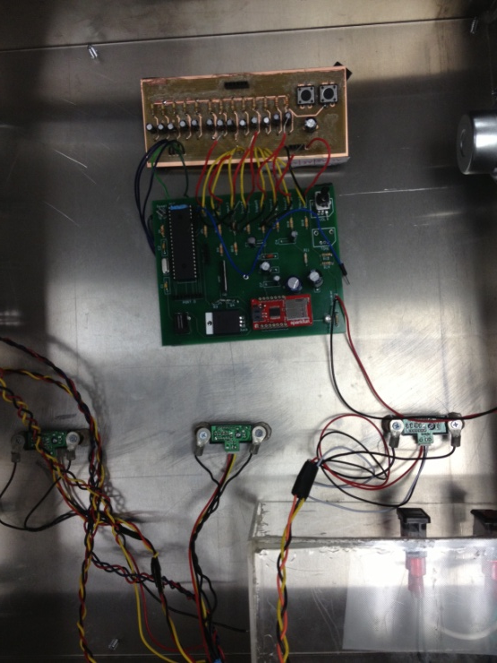
Inside Unit

Slide 38
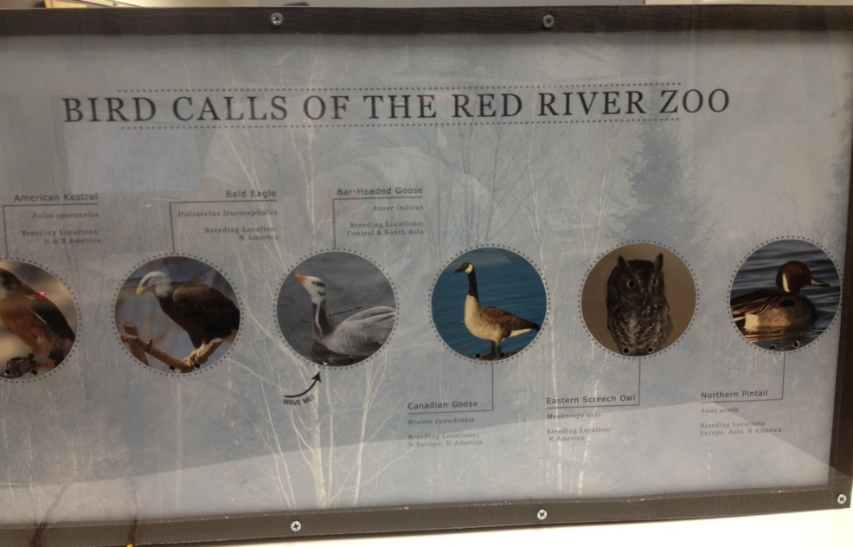
Outside Unit

Slide 39
Lessons Learned
Part Selection
Audio Chip, Microcontroller
PCB
Ground Floating Pins, Footprints, Secondary PCB
Software Design
SPI_Write(), Microprocessor, SPI, Audio Sound Length

Slide 40
Lessons Learned
Cryptic Datasheets – Audio Chip
Good Tools – Oscilloscope
Drop Down Resistors, Filtering Capacitors
Difference between Breadboard and PCB
Faulty Components – Potentiometer
Use of the Thermal Camera
Maximize the intelligence and experience of advisor and faculty in the Electrical department

Slide 41
Skills Acquired – We Learned A LOT
Ability to read Datasheets
Knowledge/Experience of Hardware Integration
Breadboard to PCB
Embedded Systems Serial Protocol
(SPI)
Better Understanding of Sensors as a Whole

Slide 42
Budget
Qty | Purch | Part | Retail | Acquired | Total
1 | Y | PIC18F4620 | 6.25 | 6.25 | 6.25
3 | Y | PIC18F4620 | 6.25 | 0.00 | 0.00
2 | Y | Light Sensors | 1.83 | 1.83 | 3.65
2 | Y | PIR Motion Sensors | 10.26 | 10.26 | 20.52
2 | Y | Digital Proximity Sensors | 4.07 | 4.07 | 8.14
2 | Y | Barometer Sensor | 2.74 | 2.74 | 5.48
2 | Y | Humidity Sensor | 4.32 | 4.32 | 8.64
1 | Y | SD Interface Break Out Board | 9.99 | 9.99 | 9.99
7 | Y | IR Proximity Sensor | 13.95 | 13.95 | 97.65
1 | Y | Weather Resistant Speaker | 6.95 | 6.95 | 6.95
2 | Y | Audio Break Out Board | 19.95 | 19.95 | 39.90
1 | Y | ISD1760 Audio Chip | 7.90 | 7.90 | 7.90

Slide 43
Budget
Qty | Purch | Part | Retail | Acquired | Total
2 | Y | ISD3900 Audio Chip | 4.23 | 4.23 | 8.46
3 | Y | Potentiometer | 1.08 | 1.08 | 3.24
1 | Y | Power Supply | 12.30 | 12.30 | 12.30
2 | Y | Hammond Chassis – 17”x15” | 51.75 | 51.75 | 103.50
2 | Y | Hammond Chassis Covers – 17”x15” | 15.30 | 15.30 | 30.60
1 | Y | Poster Display | 19.00 | 19.00 | 19.00
3 | Y | In-House PCB | - | 0.00 | 0.00
1 | Y | Final Order-Out-Of-House PCB | 52.21 | 52.21 | 52.21
2 | Y | Step Down Buck Converter | 7.50 | 7.50 | 15.00
5 | Y | Audio Amplifier | 1.62 | 1.62 | 8.10
2 | N | Audio Break Out Board | 19.95 | 19.95 | 39.90
1 | N | 2GB microSD Card | 3.00 | 3.00 | 3.00

Slide 44
Budget
Total Spent | $467.48
Total Unspent | $42.90
Grand Total | $510.38
Original Budget Requested | $652.33
Original Budget Approved | $500.00

Slide 45
Future Work
Combine both PCBs into one, ordered from out-of-house milling
Add LED lighting behind each animal so that the currently activated animal lights up
Consider other Microcontrollers and find one that is more suitable
More sounds could be added to increase flexibility

Slide 46
Future Work
LCD Interface
BlueTooth Integration
Sound Recording
Random Sound Quiz
Could be modified to fit different setting such as museum, marketing purposes, etc.

Slide 47
Summary
Project completed according to timeline projections and budget projections.
Project fulfills necessary requirements, includes desired functionality.
Finished project is non-touch activated, and plays corresponding audio files.

Slide 48
Special Thanks To…
Dr. Jacob Glower – Adviser
Jeff Erickson – Parts and Advice
Red River Zoo

